Slide 1

TECHNOLOGY

Slide 2
Poll 1
Ques – Which law is based on religious books
Civil law
Common Law
Theocratic law

Slide 3
Poll 2
Signing contracts between two companies becomes easy when their legal system is known
True
False

Slide 4
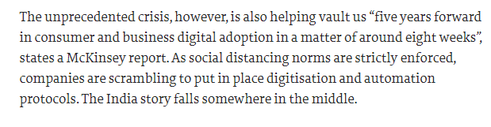
Digital Adoption -Pandemic

Slide 5
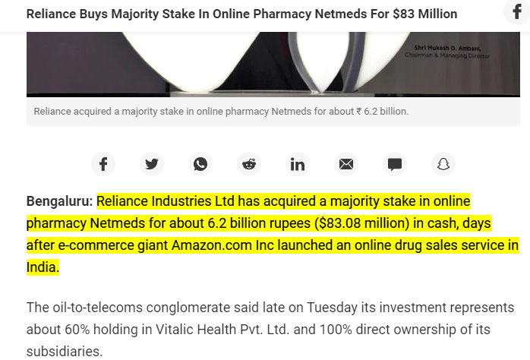
Online Healthcare
Notes:
https://www.ndtv.com/india-news/reliance-buys-majority-stake-in-online-pharmacy-netmeds-for-83-million-2281648#:~:text=Reliance%20Industries%20Ltd%20has%20acquired,drug%20sales%20service%20in%20India.

Slide 6


Slide 7

JIO FIBER

Slide 8
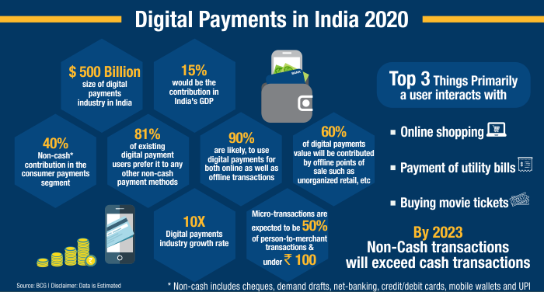

Slide 9
Virtual Stores
The virtual store is an online store that displays merchandise and an order form. A live text chat may be offered, in which the customer interacts in real time with a company representative.

Slide 10
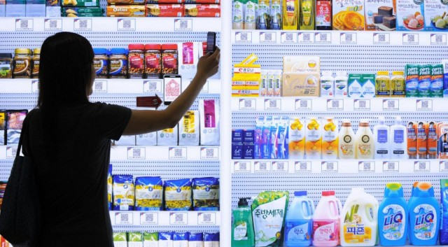
Tesco Virtual Stores

Slide 11


Slide 12
Brainstorm
As technology changes the future of jobs, is Asia prepared?
Which sectors are going to be impacted the most?
Which skills will be in demand?

Slide 13
Economic Environment
Notes:
Chapter 4: The Economic Environments Facing Business

Slide 14
Learning Objectives
Communicate the importance of economic analysis
Discuss the idea of economic freedom
Profile the characteristics of the types of economic systems
Profile leading indicators of economic development, performance, and potential
Notes:
The learning objectives for this chapter are
To communicate the importance of economic analysis
To discuss the idea of economic freedom
To profile the characteristics of the types of economic systems
To introduce the notion of state capitalism
To profile indicators of economic development, performance, and potential

Slide 15

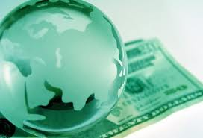
What is economic..??
Economic means "pertaining to the production and use of income.”
Economic Activities - Money earning & Spending

Slide 16
ECONOMIC ENVIRONMENT
It includes system, policies and nature of an economy, trade cycles, economic resources, level of income, distribution of income and wealth etc.
The economic environment represents the economic conditions in the country where the international organization operates.
Economic environment is very dynamic and complex in nature. It does not remain the same. It keeps on changing from time to time with the changes in an economy like change in Govt. policies, political situations.

Slide 17
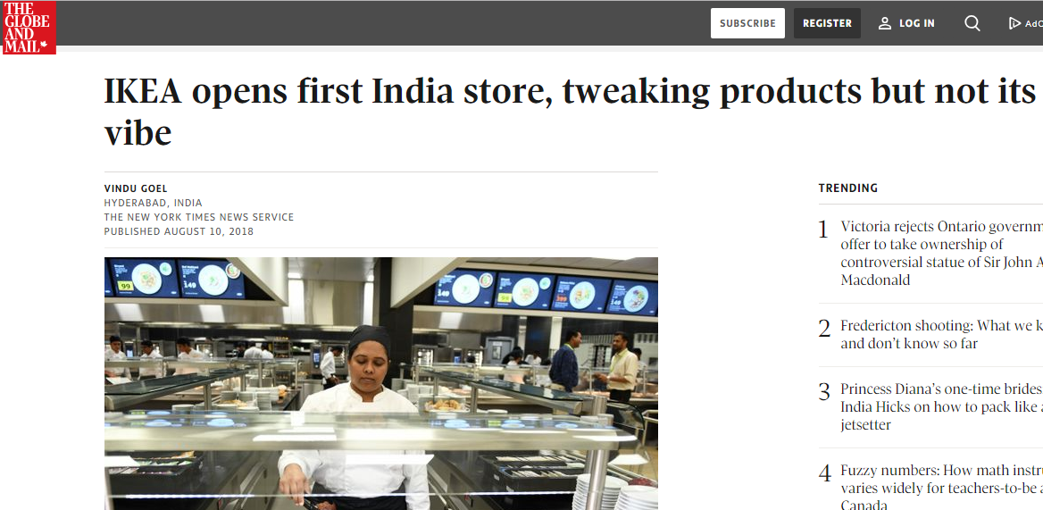

Slide 18
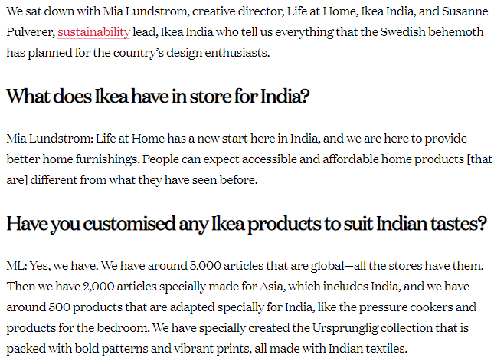

Slide 19
Objectives
To understand the concept of economic Freedom
To explore the kind of economic systems around the world
To analyze the impact of other factors on a country economic system
To analyse the impact of government policies on the country economic system

Slide 20
Introduction
Managers assess a country’s economic environment knowing:
Countries differ in different ways
Economic and political changes alter market circumstances
It is important to understand connections, change, and consequences
The challenges of the comeback
Choices of citizens, policymakers, and institutions
Notes:
Managers study economic environments to estimate how market trends and government policy influence the performance of their companies. A country’s economic policies are a leading indicator of a government’s goals and its planned use of economic tools and market reforms. Managers should study a country’s economic environment to assess its development, explain its performance, and estimate its potential. Managers do this knowing countries differ in different ways, economic and political changes alter market circumstances, that it’s critical to make connections between events and predict the consequences of changes, the challenges of the comeback, and choices of citizens, policymakers, and institutions.

Slide 21
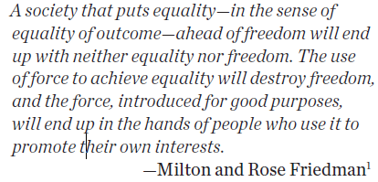
Economic Freedom v/s Equality

Slide 22
Economic Freedom
Economic freedom is the fundamental right of every human to control his or her own labor and property. In an economically free society, individuals are free to work, produce, consume, and invest in any way they please. In economically free societies, governments allow labor, capital, and goods to move freely, and refrain from coercion or constraint of liberty beyond the extent necessary to protect and maintain liberty itself.
Notes:
So, it’s important for managers to monitor a range of economic issues, but perhaps most important is an assessment of economic freedom, or what a manager has the freedom to do. Economic freedom reflects the absence of government coercion or constraint on the production, distribution, or consumption of goods and services beyond the extent necessary for citizens to protect and maintain liberty.
In some countries these freedoms are taken for granted, while in others they are rare.
Economic freedom advanced in 2011. As you might expect, it tends to be higher in Western countries and lower in Eastern countries.

Slide 23
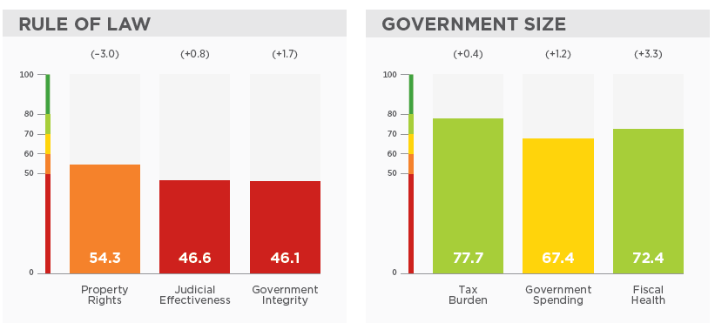
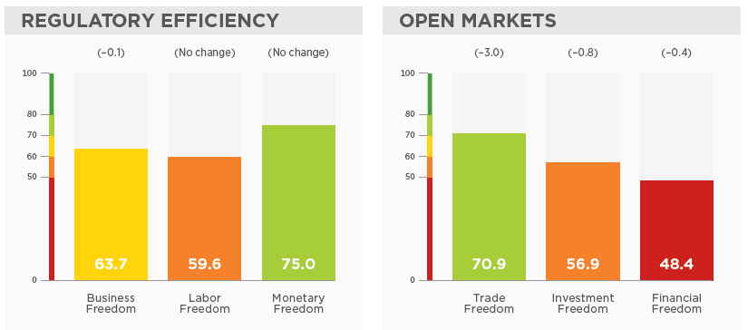

Slide 24

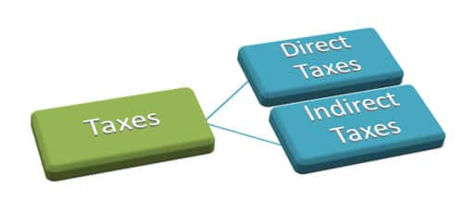

Slide 25

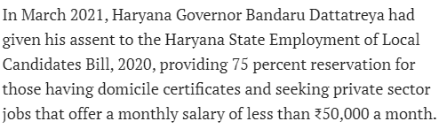
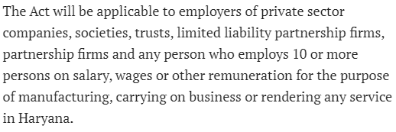

Slide 26
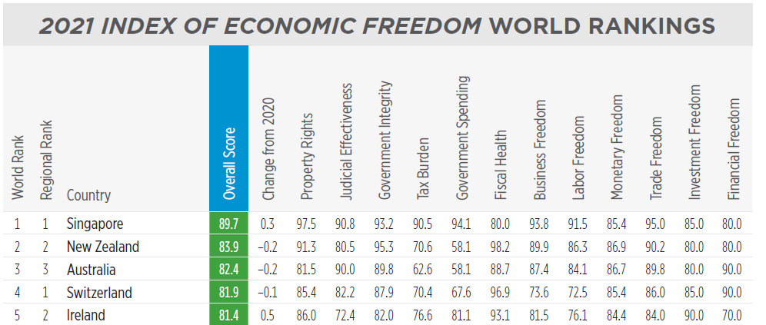

Slide 27
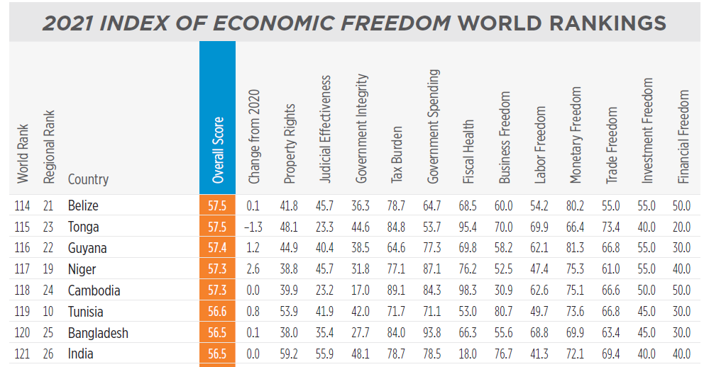

Slide 28
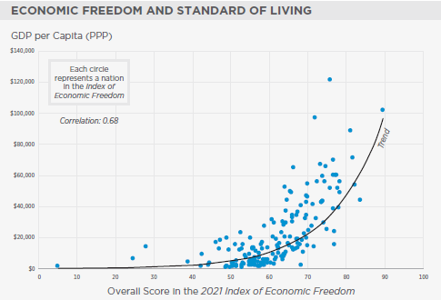

Slide 29
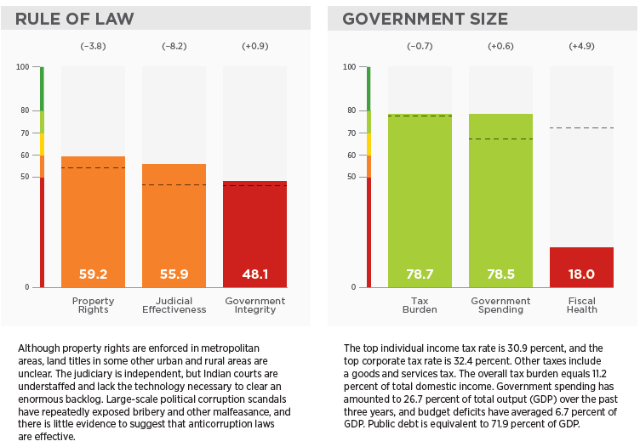
India: a glance

Slide 30
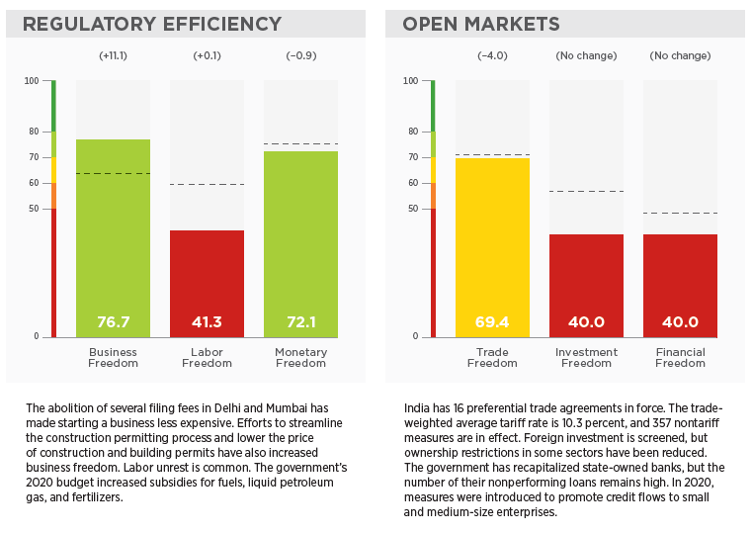

Slide 31
Value of Economic Freedom
Economic freedom affects
Growth rates
Productivity
Income levels
Inflation
Employment
Life expectancy
Literacy
Political openness
Environmental sustainability
Notes:
Why is economic freedom important? Countries with economic freedom typically have higher per capita income, standards of living, and social stability as compared to less free countries.

Slide 32
Types of Economic Systems
An economic system refers to the mechanism that deals with the production, distribution, and consumption of goods and services
Types
Market economy
Command economy
Mixed economy
Notes:
Managers can explore a country’s economic system to understand how the host government regulates the economy, protects property rights, sets fiscal and monetary policies, and enforces antitrust regulation.
There are three main types of economic systems: market, command, and mixed economies.

Slide 33
Market Economy
All productive activities are privately owned rather being owned by government
Individuals, rather than government, make the majority of economic decisions

Slide 34
Market Economy
Production is determined by interaction of demand and supply.
Monopolies are avoided which could otherwise lead to low quality goods, inefficient production system, high prices
Antitrust law in US

Slide 35
Market Economy
Entrepreneurs have a right to earn profits of their own effort hence they focus on introducing new products,improve the efficiency better marketing and aftersales service

Slide 36
Command Economy
Government owns and controls all the resources
Government plans the goods and services which the country produces,quantity and the prices.
Collectivist nations have this economic system
To mobilise the economic resources for public good.

Slide 37
Command Economy
State owned enterprises have little incentive to control cost and be efficient
Less private ownership -no incentive to people to develop new products
Dynamism and innovation absent in such economies
Economies tend to stagnate

Slide 38
Mixed Economy
In between the Market and Command economies
Certain sectors of economy are left to private ownership and free market mechanisms while other sectors have significant state ownership and government planning like India, Brazil, Italy.

Slide 39
Mixed Economy
Governments tend to take state ownership troubled firms whose continued operation is vital for national interests
Companies are saved from bankruptcy

Slide 40
State Capitalism
State capitalism refers to a system in which the government explicitly manipulates market outcomes for political purposes
promote certain industries to encourage economic development
develop national companies into global leaders
foreign companies restricted from strategic industries
Notes:
Will free markets prevail or will governments be in control? Many countries today are allowing greater state control. The adoption of state capitalism allows governments to decide how, when, and where assets are valued and resources are allocated. China has been supporting the ideals of state capitalism, and many other countries now see it as an attractive option.

Slide 41
Economic Development, Performance, and Potential
Broad classes of countries include
Developing countries
largest number of countries
low per capita income
Emerging economies
Fast growing, relatively prosperous
BRICS – Brazil, Russia, India, China, South Africa
Developed countries
High per capita income and standard of living like the U.S., Japan, France, Australia
Notes:
Managers need to assess a country’s level of economic development, performance, and potential. Countries can be classified as developing countries, emerging economies, and developed countries.

Slide 42
Elements of the Economic Environment
Gross National Income (GNI): The value of all production in the domestic economy together with the income received from other countries (mainly interests and dividends) less similar payments made to other countries.

Slide 43
GNP
Gross National Product (GNP): The value of all final goods and services produced within a nation in a given year, plus the income earned by its citizens abroad, minus the income earned by foreigners from domestic production.

Slide 44
GDP
Gross domestic product (GDP): the total value of all final goods and services produced in a country in a given year ,no matter whether produced by the domestic or foreign owned company.

Slide 45
PPP
Purchasing Power Parity – How much money is required to purchase the same goods and services in different countries
Purchasing power in different countries varies on account of cost of living which GNI not counts

Slide 46
Other Features of an Economy
Inflation
Unemployment
Debt
Income distribution
Poverty
Balance of payments

Slide 47
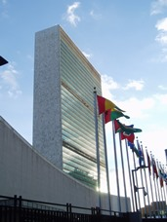
What Determines A Country’s Level Of Economic Development?
The United Nations used Sen’s ideas to develop the Human Development Index (HDI) which is based on
life expectancy at birth
educational attainment
whether average incomes are sufficient to meet the basic needs of life in a country
Notes:
Sen’s influential thesis has been picked up by the United Nations, which has developed the Human Development Index (HDI) to measure the quality of human life in different nations.
The HDI is based on three measures: life expectancy at birth (which is a function of health care), educational attainment (which is measured by a combination of the adult literacy rate and enrollment in primary, secondary, and tertiary education), and whether average incomes, based on PPP estimates, are sufficient to meet the basic needs of life in a country (adequate food, shelter, and health care).

Slide 48
What Are The Implications Of Political Economy Differences For Managers?
The benefits of doing business in a country are a function of
the market’s size
the purchasing power of its consumers
their likely future wealth
By identifying and investing early in potential future economic stars, firms may be able to gain first mover advantages (advantages that accrue to early entrants into a market) and establish loyalty and experience in a country
China
Notes:
Example: In 1960, South Korea was an impoverished Third World nation. Today, it is the fifteenth largest economy in the world as measured by GDP. Firms that recognized the country’s potential have benefited from its stunning growth.

Slide 49
What Are The Implications Of Political Economy Differences For Managers?
The risks of doing business in a country are a function of
Political risk - the likelihood that political forces will cause drastic changes in a country's business environment that adversely affects the profit and other goals of a business enterprise
Economic risk - the likelihood that economic mismanagement will cause drastic changes in a country's business environment that adversely affects the profit and other goals of a business enterprise
Legal risk - the likelihood that a trading partner will opportunistically break a contract or expropriate property rights

Slide 50
How Does Political Economy Influence Economic Progress?
Innovation and entrepreneurship are the engines of long-run economic growth
Innovation and entrepreneurship help increase economic activity by creating new markets and products that did not previously exist
innovation in production and business processes result in more productive labor and capital further boosting economic growth rates
Notes:
A country’s economic development is a function of its economic and political systems. Economic freedom associated with a market economy creates greater incentives for innovation and entrepreneurship than either a planned or a mixed economy.
The Opening Case: Political and Economic Reform in Myanmar (Burma) explores the recent political and economical changes that have increased the chances for economic progress in this country.

Slide 51
How Does Political Economy Influence Economic Progress?
Democratic regimes are probably more conducive to long-term economic growth than dictatorships, even the benevolent kind
property rights are only secure in well-functioning, mature democracies
Notes:
Country Focus: Emerging Property Rights in China explores the implications of a new property law that took effect in China in 2007. In China, all land technically belongs to the state. Land is leased to urban users for 40-70 years, and to rural users for 30 years. Under the law, urban and rural land lease holders now have the right to automatically renew their leases, or be fairly compensated if the land needs to be used for other purposes. Consequently, lease holders now have some protection against large scale appropriation by the state.

Slide 52
How Does Geography Influence Economic Development?
Countries with favorable geography are more likely to engage in trade, and so, be more open to market-based economic systems, and the economic growth they promote

Slide 53
How Is The Political Economy Changing?
Since the late 1980s, two trends have emerged
Democratic revolution (late 1980s and early 1990s)
democratically elected governments replaced totalitarian regimes
more committed to free market capitalism
A move away from centrally planned and mixed economies
more countries have shifted toward the market-based model
Notes:
Two trends are evident: first, during the late 1980s and early 1990s, a wave of democratic revolutions swept the world; second, totalitarian governments collapsed and were replaced by democratically elected governments that were typically more committed to free market capitalism than their predecessors had been.

Slide 54
How Is The Political Economy Changing?
Trend 1: Democracy has spread over the last two decades
many totalitarian regimes failed to deliver economic progress
new information and communication technologies have broken down the ability of the state to control access to uncensored information
economic advances of the last 25 years have led to increasingly prosperous middle and working classes who have pushed for democratic reforms
Notes:
These changes were most dramatic in Eastern Europe, where the collapse of communism bought an end to the Cold War and led to the breakup of the Soviet Union, but similar changes were occurring throughout the world during the same period. Across much of Asia, Latin America, and Africa there was a marked shift toward greater democracy.

Slide 55
How Is The Political Economy Changing?
Trend 2: The spread of market-based systems
more countries have moved away from centrally planned and mixed economies toward the market-based model
Command and mixed economies failed to deliver the sustained economic growth achieved in market-based countries
Notes:
The underlying rationale for economic transformation has been the same the world over. In general, command and mixed economies failed to deliver the kind of sustained economic performance that was achieved by countries adopting market-based systems, such as the United States, Switzerland, Hong Kong, and Taiwan.

Slide 56
What Is The Nature Of Economic Transformation?
The shift toward a market-based system involves
deregulation – removing legal restrictions to the free play of markets, the establishment of private enterprises
privatization - transfers the ownership of state property into the hands of private investors
the creation of a legal system to safeguard property rights
Notes:
Without a legal system that protects property rights, and without the machinery to enforce that system, the incentive to engage in economic activity can be reduced substantially.

Slide 57
What Does The Changing Economy Mean For Managers?
Markets that were formerly off-limits to Western business are now open
firms need to explore opportunities in these markets
Despite being underdeveloped and poor, some markets have huge potential
China -1.3 billion people
India – 1.2 billion people
Latin America – 600 million potential consumers
Notes:
LO4: Explain the implications for management practice of national difference in political economy.

Slide 58
What Are The Implications Of Political Economy Differences For Managers?
Countries with
democratic regimes,
market based economic policies, and
strong property rights protection
are more likely to have higher sustained rates of economic growth
these markets are more attractive to international businesses
the benefits, costs, and risks of doing business in a country are a function of the country’s political, economic, and legal systems

Slide 59
What Are The Implications Of Political Economy Differences For Managers?
The costs of doing business in a country are a function of its
political system
is it necessary to pay bribes to get market access?
economic level
are the necessary supporting business and infrastructure in place?
legal system
it can be more costly to do business in countries with dramatically different product, workplace, and pollution standards, or where there is poor legal protection for property rights
Notes:
McDonald’s found that it needed to make numerous investments in Russia in order to ensure the quality of its supplies.

Slide 60
How Can Managers Determine A Market’s Overall Attractiveness?
The overall attractiveness of a country depends on
balancing the benefits, costs, and risks associated with doing business in that country
the benefit-cost-risk trade-off is likely to be most favorable in politically stable developed and developing nations
free market systems and no dramatic upsurge in either inflation rates or private sector debt

Slide 61
From Datsun, Harley to Ford, these eight major auto companies exited India in the last five years :::::
From Datsun, Harley to Ford, these eight major auto companies exited India in the last five years. Apr 22, 2022. ...
India a tough route for global automakers. ...
Datsun. ...
Ford. ...
Harley Davidson. ...
United Motors. ...
Fiat. ...
Cleveland Motorcycles.

Slide 62
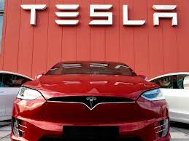
Why did Tesla fail in India?

Slide 63
Tesla has hit a roadblock in its India entry plans as the government is not willing to reduce import duties on electric vehicles.
The company has temporarily halted its plans to enter the Indian market.

Slide 64
What Ford got wrong in India?
Chennai: A combination of factors like wrong-reading of the market/product design/positioning and huge investment in a second plant when the first plant capacity itself was not fully utilised, resulted in US auto major Ford Motor Company biting the dust in India, said industry experts.

